Slide 1
Orientation
Team Leaders
IN-DISTRICT LOBBY DAYS (week of Oct. 16-20)
Thursday, Sept. 7th, 5-6:30 pm
The price of democracy is eternal vigilance and action.

Slide 2
Hats Off In-District Lobby Day Planning Team Leon Huntting, Coordinator Linda Harmeson Kathy Indermill Susan Kirsch
Team Leaders & Legislator(s)

Slide 3
Benefits of In-District Lobby Day
In-District Lobby Day is an opportunity to. . .
Influence state housing policy by using your knowledge and skills to inspire colleagues to join your;
Strengthen you and your team’s relatioteamnships and influence with elected state legislators;
Increase the visibility and stature of you, your team, and Catalysts.
Make your voice heard!

Slide 4
Agenda
5:00 Welcome, TY, Intro (name, legislator, motivation to join Lobby Day) & Benefits – Susan Kirsch
5:15 Going to the Mountain Top – Leon Huntting
Fall In-District Lobby Day Schedule
5:30 How to build your participant team? Who? How? Q&A
5:50 In-District 30-minute Meeting Format
Schedule
Flyer of Talking Points (statewide concerns)
Individualize the Meeting (local concerns)
6:10 Q&A and Next Steps
6:30 Adjourn

Slide 5
Team Leader Schedule Overview
Th, Sept 7, 5-6:30 pm – Orientation
Th, Sept 28, 5-6:30 pm - Team Leader & Participant Orientation
Th, Oct 5, 5-6:30 pm – Team Leader/Participant Q&A (optional)
M-F, Oct 16-20 – In-District Meetings
Th, Oct 26, 5-6:30 – Evaluation, Highlights & Lessons - All

Slide 6
How to build your team
Ideal Team Size: Minimum: 5 Maximum: Standing-room only!
Team characteristics: Mix of gender, ethnicity, age, political affiliations, cities
Sources to recruit Team Members:
City Councils and Boards of Supervisors, friends & neighbors
Neighborhood Association/ Homeowner Association/ Ad hoc active groups
Local Dem, GOP, Young Dems/GOP, Common Sense or other parties
Rotary, Business Clubs, etc.
Strategies: Email/phone call/living room meetings w/ intro to Lobby Day w/follow-up FAQ to email w/schedule, time, benefits, etc.
Phone follow-up; encourage “you and a friend”
Sequence: 1) Participant says “yes.” 2) Fill out the form. 3) Confirm w/the team leader. Reward for biggest team.
USE THE FORM!!! (Kathy)

Slide 7
Overview of Lobby Day – A Day in October
Time | Activity (est. 30-minute meeting)
15 min | Gather outside legislator’s office |  | Updates, review plans, roles, goals, Affirm success
5 min | Welcome, Get Seated, Intros |  | Confirm plans and materials Teams & roles (leader, note-taker, photographer, timekeeper) Schedules - ? Materials: Catalysts buttons, flyer Q&A
20 | Statewide POV. (10 min) Constituent’s present POV (10 min) w/interactive Q&A/conversational |  | Refer to leave-behind flyer – DOF, HCD, RHNA, LOCAL CONTROL Pre-planned speakers (1-3 minutes)
5 | Call to Action/Request Agreements, TY, Good-byes
10 | POST-MEETING | 10-minute + debrief

Slide 8
Working as a Team
Team Leader(s) MOVE TO TL/PARTICIAPTN day
Rotate leadership
Choose a leader from the legislator’s district
Role: Refer to the script, adapt as appropriate
Point Persons
#1: Collector: Cards from the people you meet with (turn cards into Leon)
Take notes, take pictures (with permission)
#2: Timekeeper: Monitor, tactfully/forcefully keep everyone on track
Group Members: Be attentive; respectful, be prepared to make brief statements and requests, refer to the flyer to “place” or underscore points
HCD

Slide 9
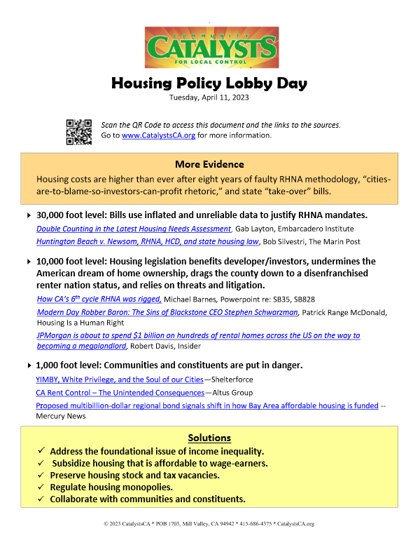
Flyer: WITH NEW CONTENT

Slide 10
In-District Lobby Week Schedule
Schedule that names:
Date: Assembly District, Leg Names, Team Leader Names, Team Members
Date: Senator Districts, Names.

Slide 11
Prep for the Meeting – FROM APRIL
NEEDS WORK!! The Legislator’s name is a live link. Visit their website to learn more about them.
The box in the lower right-hand corner of the team schedule gives links to the Housing Committees.
If you have time, check the voting records of the people you’ll meet. Be prepared to say “thank you.”
Meetings:
17 Assembly Legislators or Aides: Agilar-Curry, Alvarez, Bauer-Kahan, Connelly, Gabriel, Hoover, Kalra. Jim Patterson, Joe Patterson, Quirk-Silva, Rivas, Rubio, Sanchez, Valencia, Ward, Wilson.
7 Senate Members or Aides: Becker, Caballero, Laird, McGuire, Seyarto, Weiner, Wilk
HOUSING COMMITTEES:
Senate Housing Committee: https://ahcd.assembly.ca.gov/
Assembly Housing Committee: https://shou.senate.ca.gov/
Assembly Local Government Committee: https://alcl.assembly.ca.gov/
For bill information, go to the CA Legislative (Leginfo) website: https://leginfo.legislature.ca.gov/

Slide 12
Q&A and Next Steps

