Slide 1
Team Leaders & Participant Orientation
IN-DISTRICT LOBBY DAYS (week of Oct. 16-20)
Thursday, Sept. 28th, 5-6:30 pm
The price of democracy is eternal vigilance and action.

Slide 2
Hats Off In-District Lobby Day Planning Team Leon Huntting, Coordinator Linda Harmeson Kathy Indermill Susan Kirsch ALL the TEAM LEADERS ALL the PARTICIPANTS
Notes:
19 Team Leaders –
Intro: Name, your County & Leg Rep, - What do you hope to accomplish as a Lobby Day Team leader? OR What do you need to be successful? (20-30 seconds per person)
KI: Monitor attendance

Slide 3
Team Leaders & Legislators
Team Leaders | Legislator | Senate | Assem | Committee
Michael Barnes | Buffy Wicks |  | A-14 | HOU
Dan Broach | Kelly Seyarto | S-32 |  | AUDIT/HOU
John Eldon | Tasha Boerner-Horvath |  |  | AUDIT/LOC
Lira Filippini | Gail Pellerin |  | A-28
Lira Filippini | Jim Wood |  | A-2
Cynthia Gabaldon | Chris Holden |  | A-41
Cynthia Gabaldon | Susan Rubio | S-22
Cynthia Gabaldon | Anthony Portantino | S-25
Keith Gurnee | John Laird | S-17 |  | AUDIT
Charles Head | Phil Ting |  | A-19
Rick Johnson/Tief Gibbs | Mike McGuire | S-2 |  | HOU
Notes:
KI Attendance check (TLs & Particip on call #)

Slide 4
Team Leaders & Legislators
Team Leaders | Legislator | Sen | Assem | Committee
Amy Josefek | Ben Allen | S-24
Amy Kalish/Stephanie Cho | Damon Connolly |  | A-12
Art Kiesel | Diane Papan |  | A-21
Linda Koelling | Catherine Blakespear | S-38 |  | AUDIT/HOU
Linda Koelling | Kate Sanchez |  | A71
Liz Lawler replacement | Dave Cortese | S-15
Renee Lazear | Scott Wiener | S-11 |  | HOU
Shirley Lewandowski | Liz Ortega |  | A-20
Tom Weissmiller | Josh Becker | S-13

Slide 5
Agenda
5:00 Welcome – Susan Kirsch
Team Leaders & Participant Introductions (name, city, motivation)
Benefits & Expectations of Participation
5:15 What Team Leaders & Participants Need to Know – Leon Huntting
Overview of In-district Lobby Day Schedule
In-District 30-minute Meeting Format
Team Roles: facilitator, timekeeper, notetaker, photographer
Media: Press releases--schedule and content
Catalysts Culture Reminders (handout)
6:00 Q&A and Wrap-Up
6:30 Adjourn
Notes:
SK overview

Slide 6
Benefits of In-District Lobby Day
In-District Lobby Day is an opportunity to. . .
Influence state housing policy by using your knowledge and skills to inspire colleagues to join your team.
Strengthen your relationship and influence with elected state legislators.
Increase the visibility and stature of you, your team, and Catalysts.
Make a difference!
Make your voice heard!
Notes:
Pass the baton to Leon

Slide 7
Lobby Day Campaign Schedule Overview
Date | Time | Event
Th, Sept 7 | 5-6:30 | Team Leader Orientation
 |  | Recruit your team of co-constituents (5+) Call the scheduler to set meeting date (Oct 16-20)
Th, Sept 28 | 5-6:30 | Team Leader & Participant Orientation
 |  | Roles, Message, Ask, Outcomes, Media
Th, Oct 5 | 5-6:30 | Team Leader/Participant Q&A (optional)
M-F, Oct 16-20 |  | In-district Meetings with Legislators
Th, Oct 26 | 5-6:30 | Evaluation, Highlights & Lessons (All)
Notes:
SK overview

Slide 8
Overview of Lobby Day Meeting
Time | Activity (est. 30-minute meeting)
15 min | PRE-MEETING: Gather outside legislator’s office | Updates, review plans, roles, goals, Catalysts buttons, visualize success
5 min | Welcome, Get Seated, Intros | Introductions Team & roles (leader, note-taker, photographer, timekeeper) Confirm est. of 30 minutes, distribute flyer Q&A
20 min | Local constituent issues (5 min) Statewide housing issues: DoF, HCD, RHNA (15 min.) | Refer to flyer for talking points Pre-arrange speakers (1-3 minutes per person)
5 min | Q&A, Next Steps, TY, Good-byes | Take a picture
10 min | POST-MEETING | Debrief and take a 30-60 second video of group comments
Notes:
KI: Drop In-district Lobby Day Meeting Guidelines into Chat (pre-flight checklist)
SK: beings then back & forth with Leon
Leon: will talk about pre-meeting protocol

Slide 9
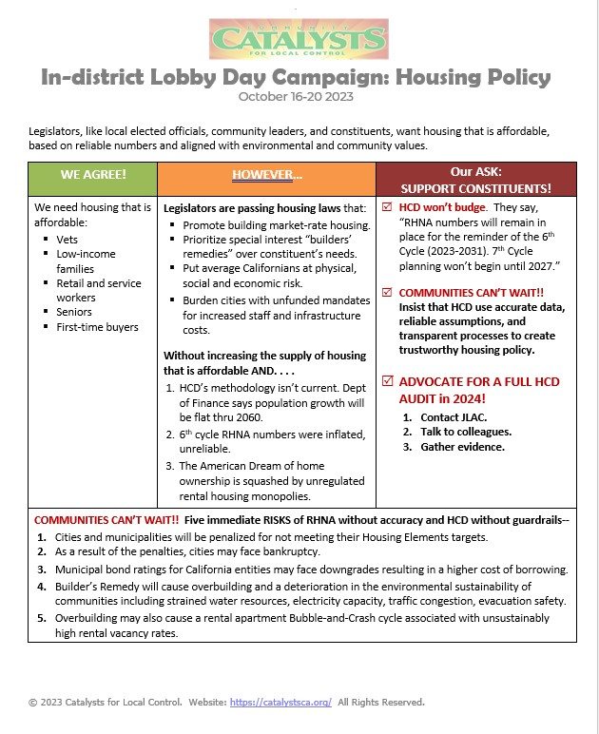
In-District Lobby Day Flyer
(Front)
Notes:
KI: drop flyer into Chat
Add notes: philosophical foundation for the flyer
Susan: Share screen for Lobby Day #1 flyer

Slide 10
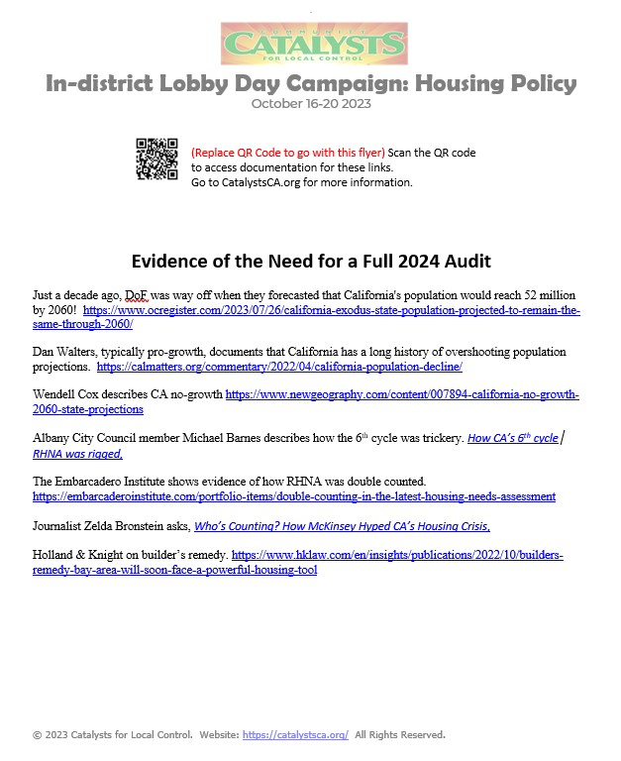
In-District Lobby Day Flyer
(Back)
Notes:
Add notes: philosophical foundation for the flyer
Susan: Share screen for Lobby Day #1 flyer

Slide 11
Catalysts Media Plan
Goal: To get media coverage in 50% of the districts
Media Plan:
Identify one or more media outlets (print, radio, TV or blog news).
Tailor the Catalysts Press Release for each jurisdiction. (See template)
PR Schedule & Procedure: Email PR, make a follow-up call, leave message, resend
Oct 2 PR #1
Oct 9 PR #2 (use quote from TL)
Oct 23 PR #3 (use photo to include with PR)
Write an Opinion Piece to submit to your local paper. (optional)
Monitor media and send coverage to Catalysts (Linda Harmeson, yr1966@comcast.net).

Slide 12
Catalysts Culture Building Blocks
Useful in Building Relationships
Useful in Reducing Defensiveness
Timeliness
Respect
Acknowledge-ment
Collaboration
Gratitude
Curiosity
Feedback
(See Catalysts Culture Reminders in Chat)
Notes:
KI: Drop Catalysts Culture Reminders into Chat

Slide 13
Q&A, Discussion, & Next Steps
Upcoming Dates:
Oct 5 – Optional orientation
Week of Oct 16-30 – Meetings
Oct 26 – Evaluation/debrief
2. Teamwork; play to strengths

Slide 14
Scheduling Process for Legislator Meetings
Sequence:
Scheduler: Find the name and email address of your Assemblymember or Senator’s scheduler. Dropped into chat. Call Leon (415-377-9612)
Email a meeting request. (sample on next slide)
If you don’t get a response in a week, follow-up with another request. Consider calling the office to get the phone number of the scheduler.
DUE DATE: Email or phone status reports to Leon (leon@loanhuntting.com)
Notes:
Leon: note who still needs help with scheduling

Slide 15
How to Build Your Team
Team Size: Minimum: 5 Maximum: Standing-room only!
Team Characteristics: Mix of gender, ethnicity, age, political affiliations, cities
Sources to Recruit Team Members:
City Councils and Boards of Supervisors, friends & neighbors
Neighborhood Association/ Homeowner Association/ Ad hoc active groups
Local Dem, GOP, Young Dems/GOP, Common Sense or other parties
Rotary, Business Clubs, etc.
Strategies: Call or email with an intro to Lobby Day and your TL role
Follow-up w/ a TY email w/schedule, time, benefits, etc. (Catalysts template)
”Join me!” to make a difference!
Use the online registration form at CatalystsCA.org—Let’s do it now!

Slide 16
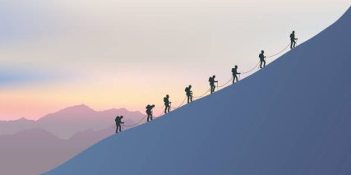
Wrap-up
We’re all in this together….
“It’s not the mountain we conquer, but ourselves.” Sir Edmund Hillary
Notes:
Leon: Closing remarks

