Slide 1
HOUSING LEGISLATION LEARNING MAP
Bill Hearings
Senate Committees
Assembly Committees
Housing
Local Govt
Environmental
Appropriations
Others
Housing
Local Govt
Environmental
Appropriations
Others
Resources
Catalysts Website
Livable CA
League of CA Cities
Calif. Legislative Information
How to Use the Legislative Portal
How a Bill Becomes a Law
2025 Legislative Calendar
2025
Housing Bills
Begin
© 2025 CatalystsCA | POB 1703, Mill Valley, CA 94942 | tel: 415-686-4375. www.Catalystsca.org All Rights Reserved.

Slide 2
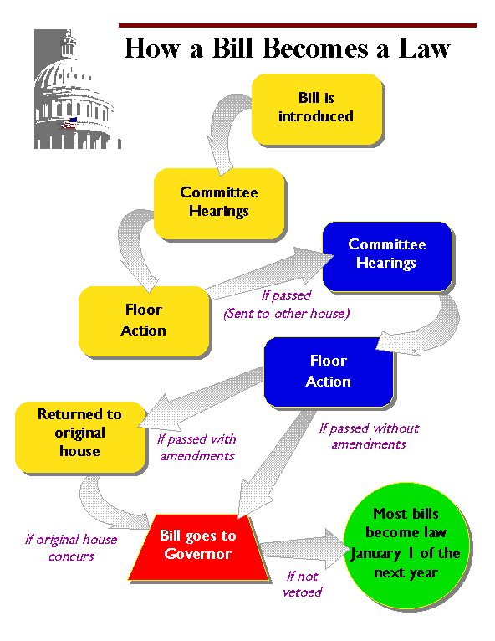
HOW A BILL BECOMES A LAW
Laws passed by the Legislature have a direct impact on your life. They can affect the taxes you pay, the number of students in your child’s classroom, and the penalty for drunk driving.
All legislation begins as an idea. Ideas can come from anyone. The process begins when someone persuades a Senator or Assembly Member to author a bill.
A legislator sends the idea and the language for the bill to the Legislative Counsel where it is drafted into the actual bill. The drafted bill is returned to the legislator for introduction.
• Life Cycle of a Bill
• The Legislative Process
© 2025 CatalystsCA | POB 1703, Mill Valley, CA 94942 | tel: 415-686-4375. www.Catalystsca.org All Rights Reserved.

Slide 3
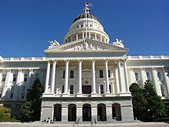
2025 LEGISLATIVE CALENDARS
DOWNLOAD CALENDAR (PDF)
• Current State Assembly Calendar
• Current State Senate Calendar
© 2025 CatalystsCA | POB 1703, Mill Valley, CA 94942 | tel: 415-686-4375. www.Catalystsca.org All Rights Reserved.

Slide 4
2025 HOUSING BILLS
VIEW LIST OF CURRENT BILLS
• By Subject
• By Bill Number
© 2025 CatalystsCA | POB 1703, Mill Valley, CA 94942 | tel: 415-686-4375. www.Catalystsca.org All Rights Reserved.

Slide 5
INFORMATION RESOURCES
• Catalysts Institute
• Livable California
•League of CA Cities
• California Legislature
© 2025 CatalystsCA | POB 1703, Mill Valley, CA 94942 | tel: 415-686-4375. www.Catalystsca.org All Rights Reserved.

Slide 6
SENATE COMMITTEES
• Overview
• Housing
• Local Government
• Environmental Quality
• Appropriations
• Others
© 2025 CatalystsCA | POB 1703, Mill Valley, CA 94942 | tel: 415-686-4375. www.Catalystsca.org All Rights Reserved.

Slide 7
ASSEMBLY COMMITTEES
• Overview
• Housing & Community Development
• Local Government
• Environmental Safety
• Appropriations
• Others
© 2025 CatalystsCA | POB 1703, Mill Valley, CA 94942 | tel: 415-686-4375. www.Catalystsca.org All Rights Reserved.

Slide 8
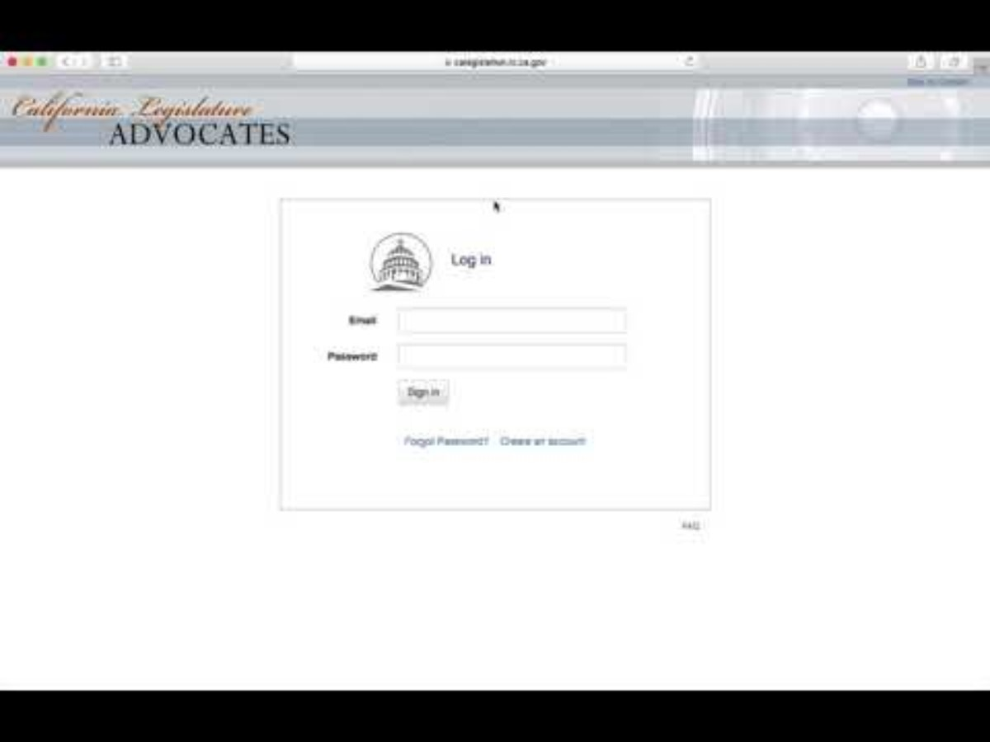
HOW TO USE THE LEGISLATIVE PORTAL
© 2025 CatalystsCA | POB 1703, Mill Valley, CA 94942 | tel: 415-686-4375. www.Catalystsca.org All Rights Reserved.

