Slide 1

Plan Bay Area 2050+ & the DEIR
A Misguided Plan...
With Significant Unavoidable Consequences
The Importance of Participation
Prep for 11/14Meetings
November 13, 2025

Slide 2
What I’ve Learned info@planbayarea.org
Public Hearing Structure
Two back-to-back hybrid public hearings on the same day, each day. The first - Draft Plan Bay Area 2050The second - Draft EIR.
The public will comment separately on the Draft PBA and the Draft EIR.
Speaker Time
11/14 - at the discretion of the Committee Chair.
Fremont and Novato hearings - up to 2 minutes, but if there are a lot of participants, the time may be reduced.
MTC-ABAG Public Info Staff at Fremont and Novato Meetings

Slide 3
Plan Bay Area2050+& the DEIR
Plan Bay Area 2050+ -
Vision: Affordable, connected, diverse, healthy, vibrant
4 Focus Areas: Transportation, Housing, Economy, the Environment
35 Strategies
Review population, jobs, transportation forecasts/projections
The Draft Environmental Impact Report (DEIR) – in compliance with the CEQA Statues, the DEIR analyzes the potential environmental impacts of the 35 strategies and ranks them as insignificant to significant and unavoidable.
65 Environmental Impacts; 52% “Significant and Unavoidable”

Slide 4
Plan Bay Area2050: How to Prepare
Plan Bay Area 2050+ -
Review the goals of the four focus areas: Transportation, Housing, Economy, the Environment
Review the strategies (listed below)
Select 1-2 strategies to talk about in two minutes. Prepare and time your script.
Begin with your name, city, group; why you care about PBA/DEIR
End with a request for the MTC Commissioners to direct staff to take action (revisit forecast assumptions, methodology, common sense; and “thank you.”
RESOURCES:
Catalysts Resource Page (recording of 11/3 meeting with Guy Lion, Tom Rubin, Gregg Dieguez and their slides
Plan Bay Area 2050+ October 2025 Executive Summary (.PDF)

Slide 5
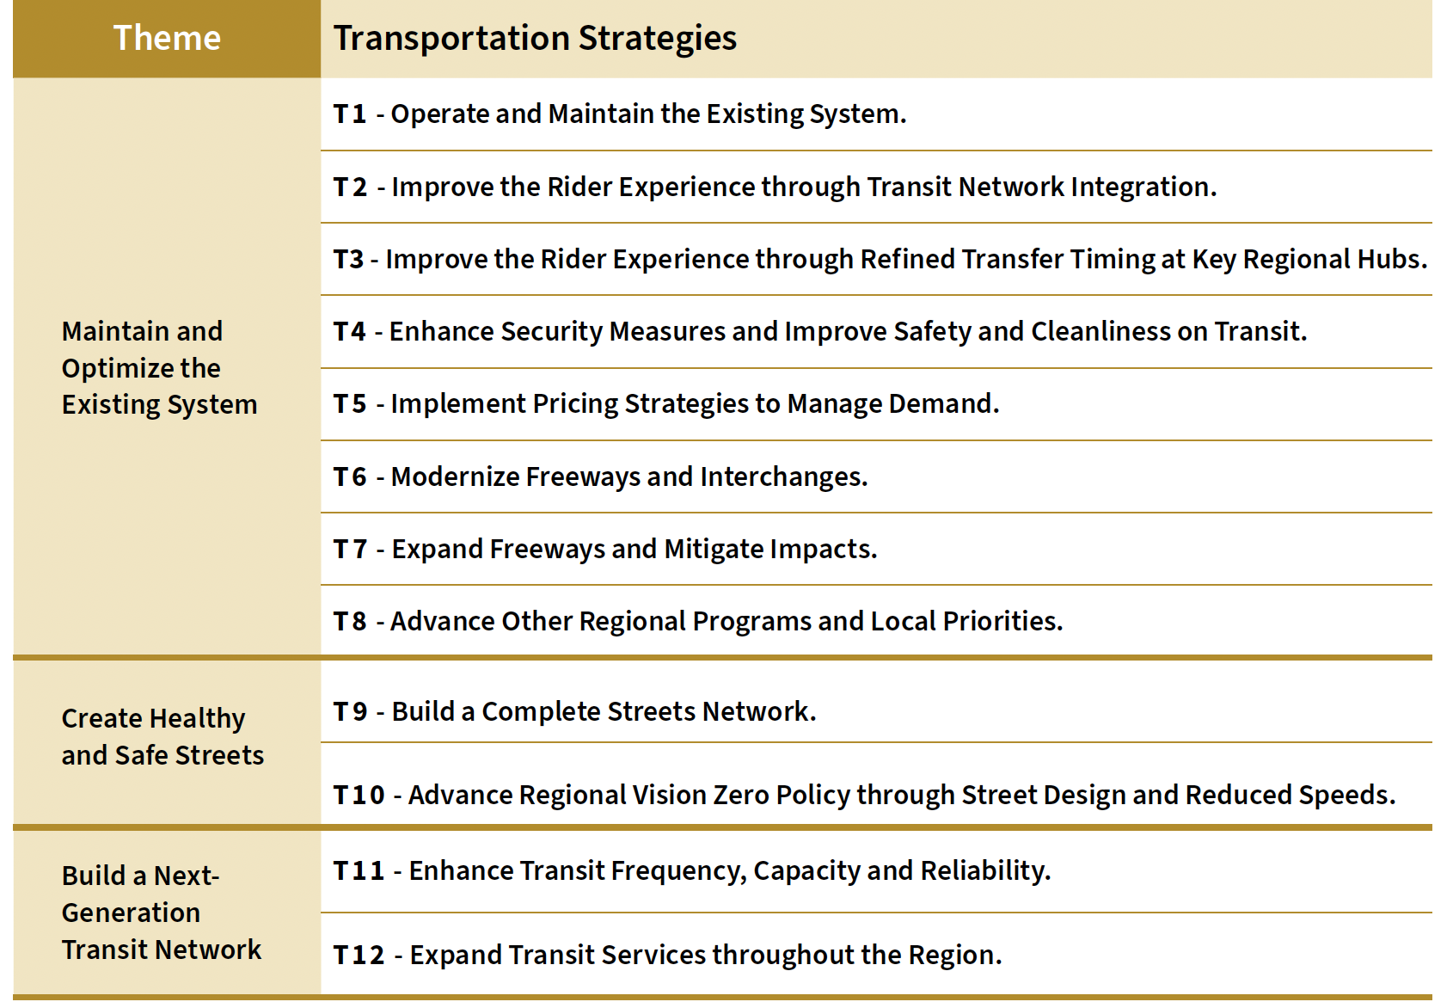
Plan Bay Area: Transportation Strategies

Slide 6
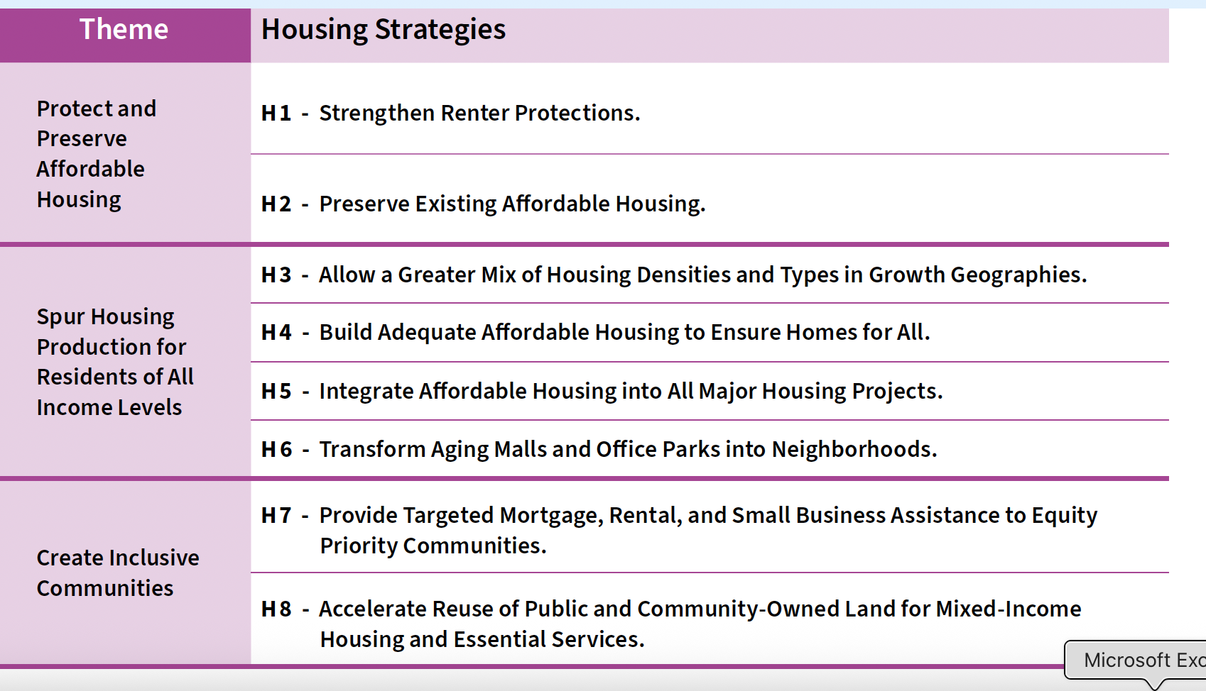
Plan Bay Area: Housing Strategies

Slide 7
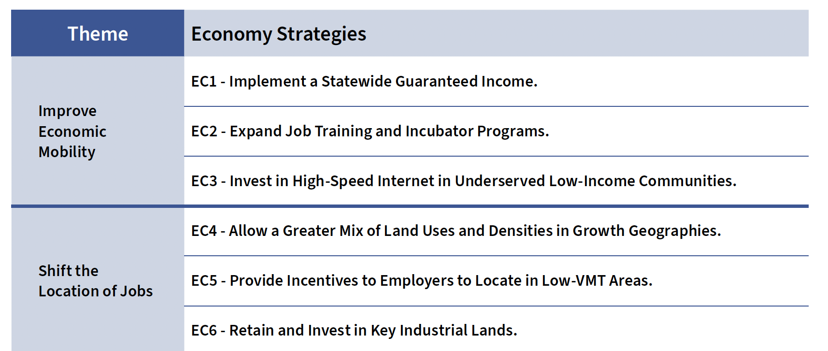
Plan Bay Area: Economy Strategies

Slide 8
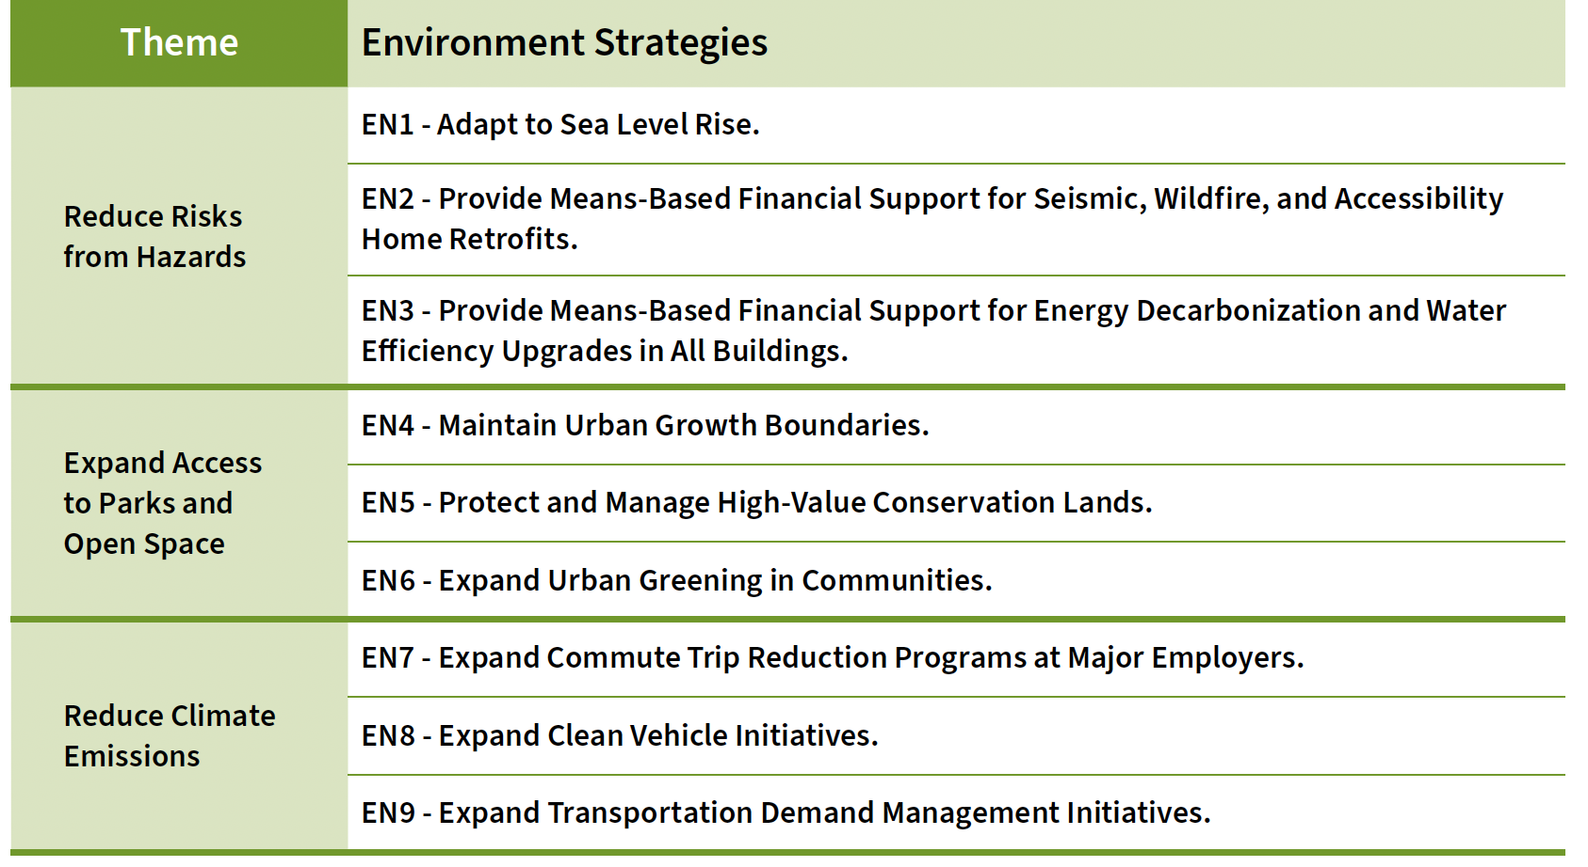
Plan Bay Area: Environment Strategies

Slide 9
Draft EIR: How to Prepare
Draft EIR -
Review Table ES-1: Summary of Impacts and Mitigation Measures (Catalysts Resource Page)
Review Table 4-34: Summary Comparison of Impacts
Review the Catalysts 2-minute Scripts (dropped into chat)
Select 1-2 strategies to talk about in two minutes. Prepare and time your script.
Begin with your name, city, group; why you care about PBA/DEIR
End with a request for the MTC Commissioners to direct staff to take action (revisit forecast assumptions, methodology, common sense; and “thank you.”
RESOURCES:
Catalysts Resource Page: (MTC documents, recordings, slides from 11/3 presentation)
Plan Bay Area 2050+ Draft Environmental Impact Report (.PDF), Table ES-1: Summary of Impacts and Mitigation Measures

Slide 10
Resources
https://catalystsca.org/plan-bay-area-2050-2/
Plan Bay Area 2050+ October 2025 Full Document (.PDF)
Plan Bay Area 2050+ October 2025 Executive Summary (.PDF)
Plan Bay Area 2050+ Draft Environmental Impact Report (.PDF)
Plan Bay Area 2050+ Draft Project Performance and Draft Transit Network July 2024 (.PDF)
Catalysts Call recording – November 3, 2025
Presenter Slides (pdf and PPTX)
“Plan Bay Area’s draft report appears built on false narrative,” Susan Kirsch, Marin Voice, Marin Independent Journal, Nov. 10.
Marin Voice sent to City Council clerks in 101 cities and 9 counties

Slide 11
The Challenge. . .
Ambitious planning for economic growth = significant risks for quality of life and safety.

Slide 12
The Opportunities
Opportunity to identify the weakness of PBA/DEIR
Use the language of ‘inadequate, unreliable, unreplicable” when the plan refers to forecasts, models, assumptions, projections that present unrealistic numbers
Significant hazardous impacts without mitigation to remedy them
Identify ignored cumulative impacts (air quality, climate change and GHG emissions, cultural resources, hazards and wildfire, transportation
Failure to identify reasonable range of Alternative Plans by presenting the “No Project” and “Preferred Plan” as functionally the same, preventing meaningful analysis.

Slide 13
Schedule
Fri, 11/14, 9:40 am, Metro Center, 375 Beale St, SF – MTC Planning/ABAG Administrative Committee. Action: Show up. Bring a friend. Speak for 2-3 minutes on PBA and the DEIR. Meet like-minded colleagues.
Th, 11/20, 5 pm, Metro Center, MTC/ABAG ExCom. Action: Show up. Hear the report from the 11/14 meeting. Speak during public open time.
Wed, 12/3, 6 pm, Olive Hyde Art Center, 123 Washington Blvd, Fremont
Th, 12/4, 6 pm, Best Western Novato Oaks, 215 Alameda del Prado, Novato
Th, 12/18, Deadline for comments Action: Submit written comments to go int the public record that require a response.
Spring 2026 – MTC/ABAG Board Meeting to vote on (1) “Statement of Overriding Considerations.” SOC claims the benefits of PBA override the significant and unavoidable consequences; then approve the EIR. (2) Approve PBA2050+.

Slide 14
MTC Planning Committee
Name | County/City | Representing | MTC/ABAG (County & Cities rep) | Phone | Email
Eddie Ahn (Chair) - | San Franciso | Bay Conservation Development | MTC | 415-778-6700 | eddie.ahn.mtc@gmail.com
Candace Andersen | Contra Costa, Danville | BOS | MTC | 925-655-2300 | candace.andersen@bos.cccounty.us
Pat Burt (Vice Chair)] | Santa Clara, Palo Alto |  | MTC/ABAG | 650-308-9824 | pat@patburt.org
David Canepa | San Mateo, Daly City |  | MTC/ABAG | 650-363-4572 | dcanepa@smcgov.org
Marilyn Ezzy Ashcraft | Alameda, Alameda |  | MTC/ABAG | 510-747-4701 | mezzyashcraft@alamedaca.gov
Dorene M. Giacopini* | San Francisco | US Dept of Transportation | MTC | 510-918-3538 | dgiacopini@bayareametro.gov
Alicia John-Baptiste | San Francisco | SF-Mayor’s Appointee | MTC- | 415-603-9450 | a.john-baptiste@sfgov.org
Matt Mahan | Santa Clara | San Jose Mayor’s Appointee | MTC | 408-535-4900
Mitch Mashburn | Solano, Vacaville |  | MTC/ABAG | 707-784-6130 | MHMashburn@SolanoCounty.com

Slide 15
December 18th:
Before Dec. 18, submit comments in writing that raise specific PBA/DEIR issues related to questionable methodology, faulty modeling, unsupported conclusions, significant hazards, cumulative impact, consideration of Alternative Plans
eircomments@bayareametro.gov
Subject line: Draft EIR
Request concrete actions such as update the data or analysis, require congruence with other studies, give renewed consideration for Alternative Plans like the “Local Control Alternative.”

Slide 16
Questions

