Slide 1
MTC/ABAG Demographic Forecast
Gaetan “Guy” Lion, November 3d, 2025

Slide 2
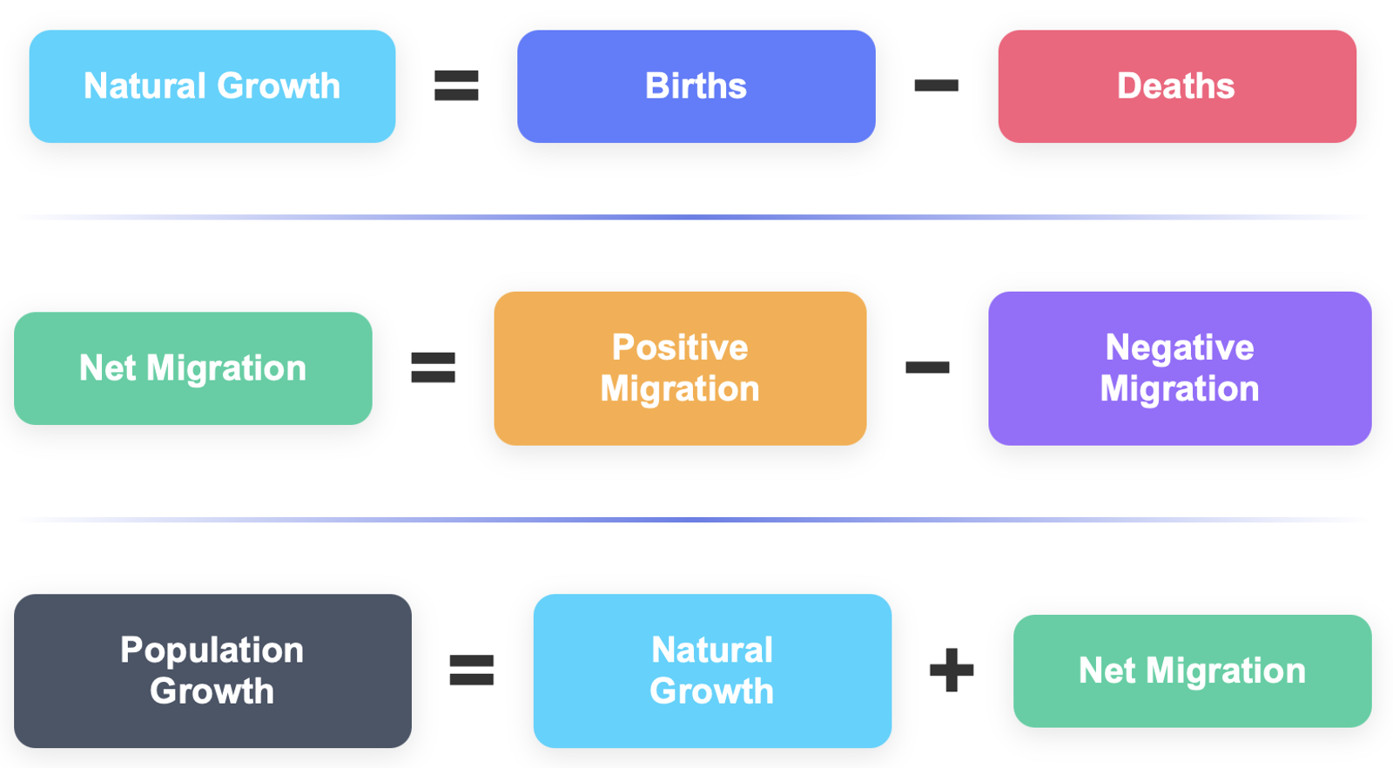
Basic framework of a Demographics Model to forecast Population Growth
That is how the California Department of Finance Research Demographics Unit (DRU) develops their population forecast. They go through this decomposition at the County level for each of the nine counties of the Bay Area.

Slide 3

What MTC/ABAG stated they did…
They did not bother with any demographic metrics (births, deaths, net migration). They came up with an aggregate Bay Area Job figure that in turn drove population than households and ultimately housing units. No disaggregation at the county level whatsoever.
As shown above, this model has Jobs as the main driver and independent X variable. And, Housing Units is the ultimate dependent Y variable.

Slide 4

What MTC/ABAG actually did…
They first came up with a Housing Target by 2050 and tweaked all their intermediary variables’ assumptions to justify their Housing Target by 2050.
The MTC/ABAG model is not a demographic model. It is a set of assumptions to justify a Housing Target by 2050. The assumptions are disconnected from existing demographics and economics trends.

Slide 5
MTC/ABAG confirming their biased modeling strategy
“To implement this feedback impact, housing strategies were tested in BAUS2 to find a package that would allow for the construction of sufficient low-income deed-restricted units and market-rate units by 2050.”
Source: Page 7 of Plan Bay Area 2050 + Forecasting and Modeling Report October 2025

Slide 6
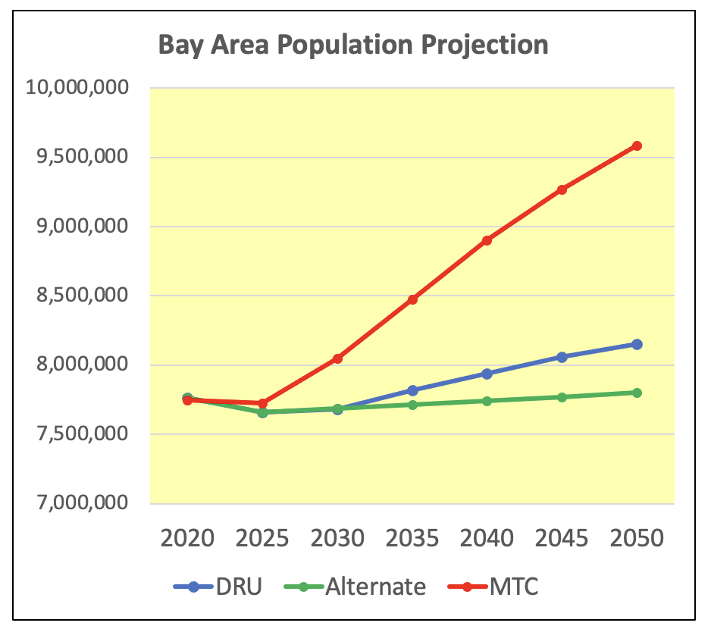
Flawed Model = Unrealistic Bay Area Population Growth
Current Bay Area population is 7.7 million.
By 2050, DRU projects that it would increase to 8.1 million.
An Alternate scenario assuming more realistic net migration projects 7.8 mm.
Meanwhile, MTC/ABAG projects 9.6 mm.
The MTC/ABAG projections are disconnected from any demographic and economic trends.

Slide 7
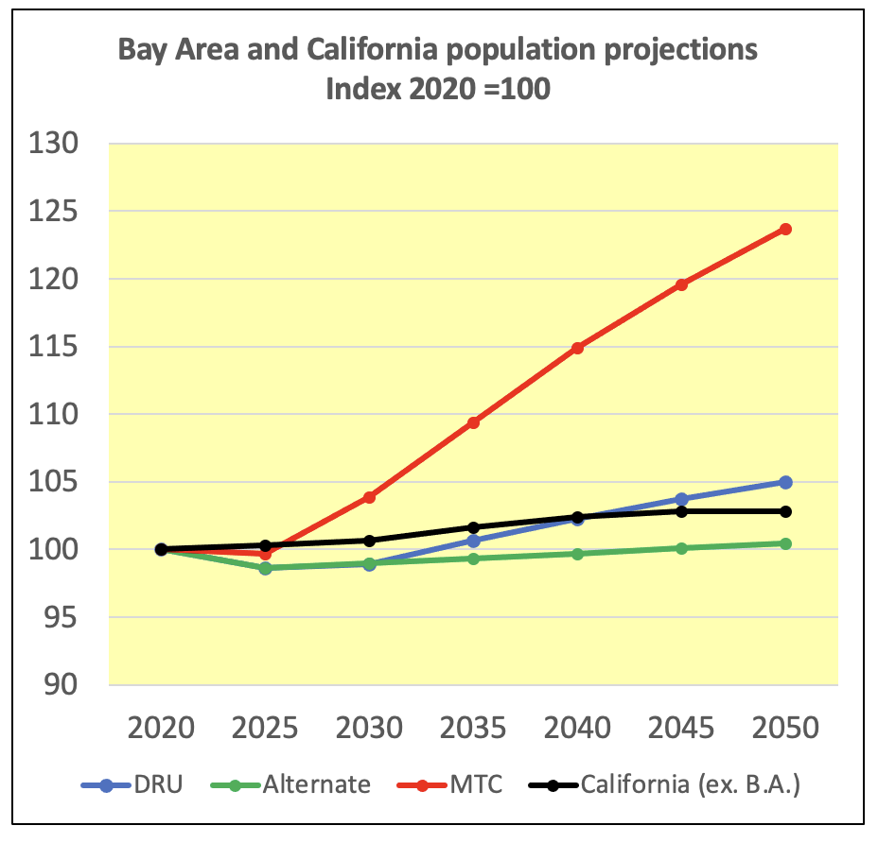
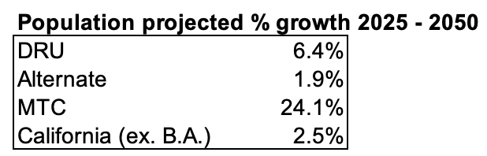
The shown data is disclosed on an indexed basis (2020 = 100).
Over the 2025 – 2050 period, MTC/ABAG growth at 24.1% is:
3.8 times faster than DRU
12.7 times faster than the Alternate scenario
9.6 times faster than DRU projection for California excluding the Bay Area

Slide 8
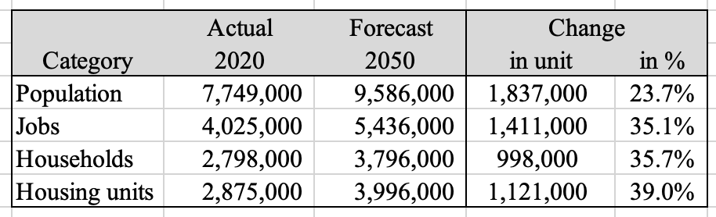
MTC/ABAG Projections of Population, Jobs, Households, and Housing Units
Source: MTC/ABAG
The population projections are already way too high. The ones for Jobs, Households, and Housing Units are even more unrealistic.
Notice that MTC/ABAG started with 2020.
Our analysis used history 2000 – 2025 and projections 2025 -2050.

Slide 9
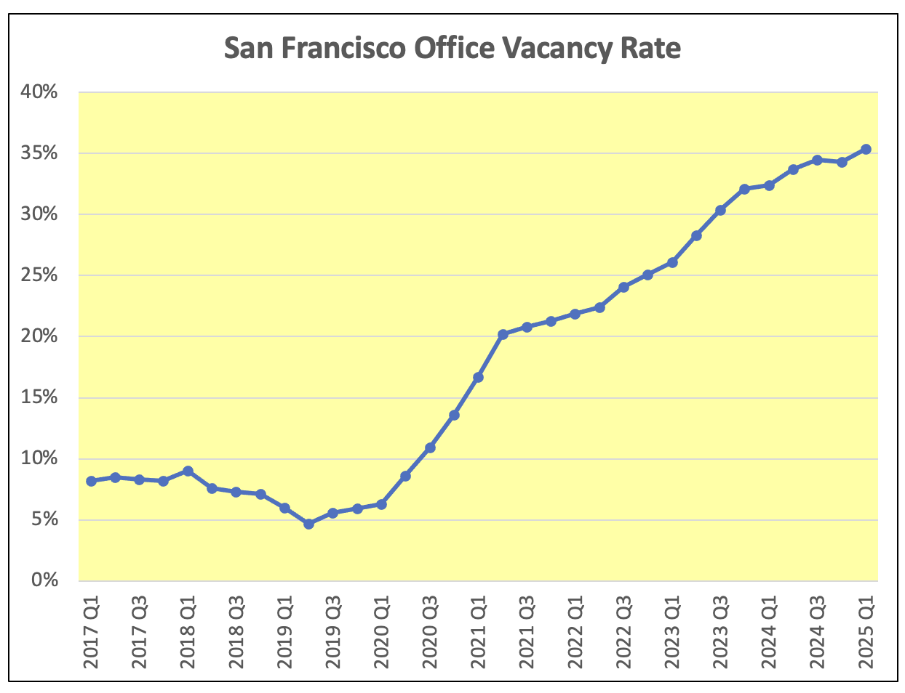
A metric to assess the growth prospect for Jobs, Population, and Housing
The nationwide commercial office space crisis has not abated. It is getting worse. San Francisco has the highest vacancy rate among major markets (> 35%). San Jose and Oakland vacancy rates are following a similar rising trend; and are at their respective record levels.
Remote work, traffic, adverse migration trends & policies, high costs have a permanent effect on the Bay Area’s prospective growth.

