Slide 1
“IMPROVE ECONOMIC MOBILITY”
DEIR p. 2-8, “EC4: Implement a Statewide Guaranteed Income |$205 Billion| Provide an income-based payment to all Bay Area households to improve family stability, promote economic mobility, and increase customer spending.” (emphasis in original)
Assuming this State-wide program goes into full effect in for the FY31-FY50 period, that’s $10.25 billion a year going to an average of ~3.5 million Bay Area households, just under $3k a year for ALL households
For just the lowest-earning million, households, that would be about $10k/year each – presumably, in addition to all existing governmental and private sector aid programs
Although this is labeled as a Statewide program, the Bay Area is such a large portion of the State population that is difficult to conceive how the Bay Area taxes to support this would come from anywhere but Bay Area taxpayers – so the 2.5 million households not getting these funds would each be paying in >$4k year
There does not appear to be anything in the Plan that considers how many high-earners – and mid-earners – this would cause to leave, or the jobs lost, or the higher costs of doing business increasing prices, etc., etc., etc.

Slide 2
Water Shortage? WHAT Water Shortage?
DEIR, page 3.14-11: “Although the Bay Area’s population grew steadily for several decades, recent estimates indicate a slight downward population trend since 2020, largely driven by out-migration and other factors. Despite this recent decline, many water agencies project that long-term population in the region will either stabilize or gradually rebound …”
Evidently, no one told the authors of DEIR Section 14, Public Utilities and Facilities, that the authors of Section 11, Land Use, Population, and Housing, were projecting a 23.7% increase in population from 2020 to 2050 (Table 4-1, page 4.12)

Slide 3
NO PLAN B
The entire Plan Bay Area 2025+, like all of its predecessors, is build a huge number of unrealistic assumptions, most of which have negative feedback to other assumptions
All of the predecessors have already been shown to be unrealistic
There is absolutely no realistic alternative presented for a fallback when the unrealistic assumptions, and the outcomes built on them, can no longer be denied
THIS IS A FAILED PLAN – and A PLAN TO FAIL

Slide 4
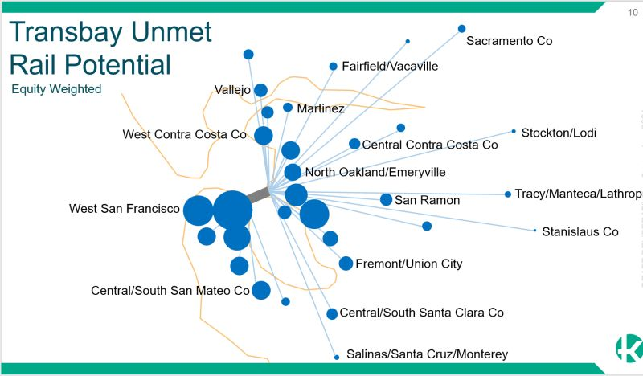
The Network Is The Problem
Everyone,
From Everywhere,
All At Once…
… is costly network design…
Put the jobs where the people want to, and can afford to, live…
or have the cities pay for the transit..

Slide 5
Transit Is Out-Moded: $500B
Now: “Carrying your Thanksgiving Turkey home in the rain…”
Can we envision a “transit” system that picks you up at home, takes you the store, and brings you home?
Could AV’s such as mini-vans be dynamically routed to pick up half a dozen passengers and drop them off, as airport vans do?
Would this save Billions in capital costs?
Would this save Billions in Union Wages and Pensions?
Where was this future analyzed in PBA2050+?
Nowhere that we can find…

Slide 6
Housing Is Misplaced: $500B
Proposed public(?) cost over 25 years, vs. $20B in failed RM4 (details missing)
PBA2050+ tries to justify failing downtowns and transit systems by pushing ‘housing’ closer to transit
Current Housing policies claim shortage, but vacancies (and STR’s) are high.
Affordability is a valid concern… but prices are driven up by wealthy corporation employees… not shortages.
Plan does not address un-affordability from cost of infrastructure, water, sewer, insurance, taxes…

Slide 7
Current Housing Policy = Failure
Percent Change From 2023 to 2050 Under No Plan | Percent Change From 2023 to 2050 Under All Strategies | Outcomes
0% | +30% | Home ownership rate for households with low incomes
The Plan* admits current policies won’t grow home equity for lower income housholds
Current Housing Policy makes Wealth Inequality worse…
… By subsidizing wealthy investors (WIMBY) who profit, and by sentencing residents to Rent Slavery with no equity to build wealth.
“The problem is not a housing shortage, it is a shortage of low-income housing, which is due in large part to governmental actions – and the proposal is, because the governmental actions have failed, we need a lot more governmental action. This is the equivalent of treating blood loss by bleeding the victim.” – Tom Rubin
*Figure 5-9 page 115

Slide 8
Flawed Housing Assumptions**
MTC adjusted the REMI model’s “relative housing price” variable downward starting in 2022 so that by 2050, Bay Area home price relative to the U.S. would be back to 2001 relative difference levels. Erasing 25 years of evidence.
This is a most unlikely outcome because of rising development costs and land premium associated with the Bay Area being the leading AI hi-tech hub in the world.
MTC forced the model to give it the results they wanted.
** Again, THANKS to Guy Leon

Slide 9
Economic Concerns
Universal Basic Income: $205B
Given current wealth inequality and more automation coming, jobs for humans is a valid concern.
A STATE-wide UBI program would just increase in-Migration to CA and cost us more $$$.
A NATIONAL UBI, if agreed, could help move excess people to the Rust Belt and more affordable places.
Since the U.S. A. can’t fund Social Security, it is ridiculous to include this proposal in a REGIONAL plan, until national fiscal issues are under control.
Shift the location of Jobs: $25B
Proposed: move the people into the core cities and growth zones.
Preferred: move the jobs to where the people want to live, reducing commute time and cost.
Issue: why should we pay to rescue decaying urban cores?

Slide 10
Environmental Concerns
Sea Level Rise - $96B
Approach unclear, unjustified
Asset replenishment costs are 4x ever 40 years…
Relocate Responsibly, don’t Resist Ridiculously
DEIR – significant unmitigated risks
67 environmental impacts with 41 “Significant and Unavoidable” – What are those benefits, who receives them, and who bears the costs?
Until the population assumptions are valid, and each of those 41 impacts has a credible mitigation & accountability plan, approving this DEIR is premature.
Expand Access to Parks and Open Space: $62B
Sounds good, but the reasoning is linked to increased density and trying to help people cooped up in their apartments.
How about giving people trees in their back yards?
Debate: Mandated Density vs. Enjoyable Sprawl

Slide 11
Other Problems With PBA2050+
Biased estimation methods – Bad Faith “Planning”
Lacks supporting justification in detail…
…Thus, lacks Transparency
Failure to inventory fiscal conditions as fact base
Failure to assess cost/benefit
Omits healthcare, education, job creation, and more…
No binding, independent, oversight and accountability
Invalid, unaccountable, totalitarian planning process
MTC, et al, record of mismanagement
Detached from both reality and accountability

Slide 12
Immediate Process & Concerns
MTC/ABAG will be voting on the Draft EIR in December.
Beginning with the population estimates, the Plan is a fraud.
Inflated population to justify the Transit and Housing costs
41 of 67 Concerns in the DEIR are "significant and unavoidable
To approve the DEIR, MTC would have to approve those estimates AND approve a Statement of Overriding Considerations.
Our goal: make that vote Very Uncomfortable for them.

Slide 13
Our Next Steps
Those are some of the concerns we'll be researching and substantiating.
We'll post sample public comment talking points a few days before the Nov. 14th MTC meeting.
We’ll create and speak to a slide show ASAP.
We’ll create written public comments for Dec. 18th
Eventually, we'll have articles and papers documenting our findings.
We’ll campaign about Regional Measure 5 on the Nov. ‘26 ballot.

Slide 14
What is needed
Public awareness of the problem, and the solution
A vision of a more agile and affordable transit future
Your insights on how to analyze and present the issues:
What are we missing?
What venues should we use to communicate?
Who can we contact at AV firms?
Opportunities for SHIFT to speak in public
Social media support
Donations to fund our efforts
Voters to turn out in opposition!

Slide 15
So What and Now What?
Pressure MTC/ABAG to vote NO on the Draft EIR
Speak: public comments at Nov. 14 MTC meeting
Write: public comments by Dec. 18 to email.com
Use the online comment form at planbayarea.org/draftplan
Email info@planbayarea.org (subject line: “Draft Plan”)
Suggest improvements for the plan to SHIFT
Arrange for speaking engagements for SHIFT authors
Spread the word on Social Media
Speak at City and County Councils
Talk to your friends and neighbors

Slide 16
Susan Kirsch Proposed Schedule
For greatest impact, I suggest this timeline. It's based on the speaker's principle: 1) Tell 'em what you're going to tell 'em; 2) Tell 'em; 3) Tell 'em what you told 'em." It corresponds to 1) make a call/ leave a message the week of 11/14; 2) send the email w/tallking point; 3) deliver one or more of the talking points 11/14; 4) repeat the message in written comment due 12/18.
11/3 - Catalysts Call with a presentation of draft key talking points
11/4+ - Finalize talking points and email
11/10 - Catalysts Call - final key talking points, share email to MTC/ABAG reps; confirm distribution calls (with script) and talking points for 11/14 meeting (w/template)
11/10-13 - Make heads-up calls/leave messages for members of MTC/ABAG; send email w/talking points
11/14, 9:40 am. - 20+ people attend in person and use 2-minute comment time to speak to one or more of the talking points; repeat, "Without adjustments, vote NO on Draft EIR.
11/17 - Catalysts Call - "What'd we learn from 11/14 hearing?" Adjust for 12/3 and 12/4 hearings. Recruit for 20+ attendance
11/18-12/18 - Work on individual/group responses to BPA/DEIR
11/24 - Catalysts Call - Plans for 12/3 and 12/4 meetings;

Slide 17
Your comments and suggestions?
Plan Bay Area 2050+
More Flaws to Cite? Understandable concerns? Believable evidence?
Desired Next Steps and Priorities?
mccgreggd@gmail.com

Slide 18
“The Ultimate Test of a moral society is the kind of world that it leaves to its children.” - Dietrich Bonhoeffer
Why Should We Care?

