Slide 1
Tom Rubin’s Slides
For Catalyst
11/3/25 Meeting

Slide 2
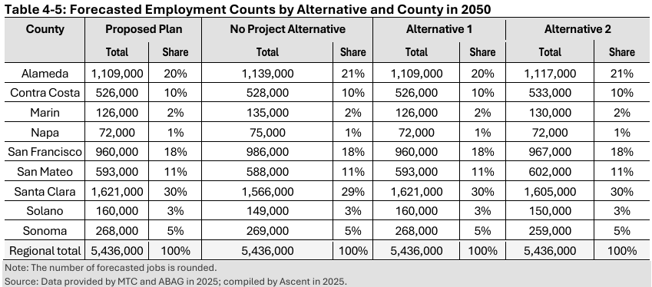
PLAN POPULATION/JOB GROWTH IS CONSTANT
No matter what the alternative, the total 2025 jobs are the same; just minor shifts between jurisdictions
Ridiculous to assume, for example, without MTC’s assumed extreme jobs/ population concentration, no road capacity growth, and assumed transit growth that the extreme growth could occur without ability to move around

Slide 3
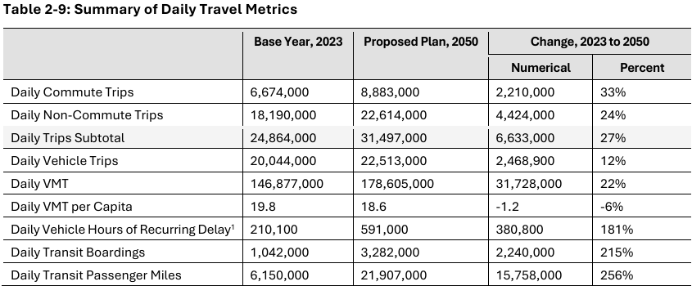
TRAVEL OUTCOMES MAKE NO SENSE
Daily Transit Boards and Passenger-Miles are overstated; Boardings was 888k (MTC was 17% too high); P-M was 5,119K (MTC was 20% too high)
This makes required growth in Boardings and P-M in 2025 370% and 428%, respectively, of 2023
To achieve the 2050 values, average annual growth rates of 4.95% and 5.53% needed – WHICH NO MAJOR U.S. TRANSIT SYSTEM HAS DONE POST-WWII
Notes:
DEIR, Table 3.15-2: Public Transit Operators in the Bay Area, page 3.15-4, lists 26 operators which MTC shows with their individual Average Weekday Ridership;; no total is provided, but the sum of these is 881,000. After correcting some MTC omissions (including the 3,480 daily vanpool riders that MTC itself operates and reports, I got a slightly higher total.

Slide 4
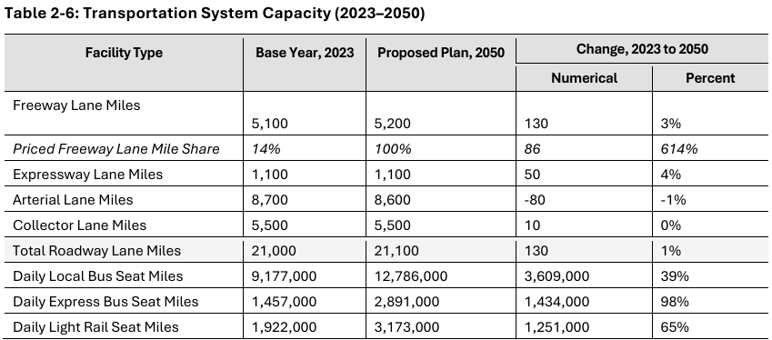
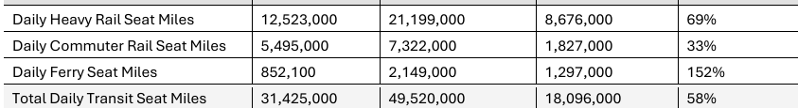
TRANSPORTATION CHANGES REDICULOUS
Almost no new growth in road miles at all
Transit seat-miles 158% of 2023 – but Table 2-9 has passenger-miles 309%, so load factors will almost double; questionable under the basic law of physics that two objects cannot occupy the same space at the same time

Slide 5
“IMPROVE ECONOMIC MOBILITY”
DEIR p. 2-8, “EC4: Implement a Statewide Guaranteed Income |$205 Billion| Provide an income-based payment to all Bay Area households to improve family stability, promote economic mobility, and increase customer spending.” (emphasis in original)
Assuming this State-wide program goes into full effect in for the FY31-FY50 period, that’s $10.25 billion a year going to an average of ~3.5 million Bay Area households, just under $3k a year for ALL households
For just the lowest-earning million, households, that would be about $10k/year each – presumably, in addition to all existing governmental and private sector aid programs
Although this is labeled as a Statewide program, the Bay Area is such a large portion of the State population that is difficult to conceive how the Bay Area taxes to support this would come from anywhere but Bay Area taxpayers – so the 2.5 million households not getting these funds would each be paying in >$4k year
There does not appear to be anything in the Plan that considers how many high-earners – and mid-earners – this would cause to leave, or the jobs lost, or the higher costs of doing business increasing prices, etc., etc., etc.

Slide 6
Water Shortage? WHAT Water Shortage?
DEIR, page 3.14-11: “Although the Bay Area’s population grew steadily for several decades, recent estimates indicate a slight downward population trend since 2020, largely driven by out-migration and other factors. Despite this recent decline, many water agencies project that long-term population in the region will either stabilize or gradually rebound …”
Evidently, no one told the authors of DEIR Section 14, Public Utilities and Facilities, that the authors of Section 11, Land Use, Population, and Housing, were projecting a 23.7% increase in population from 2020 to 2050 (Table 4-1, page 4.12)

Slide 7
NO PLAN B
The entire Plan Bay Area 2025+, like all of its predecessors, is build a huge number of unrealistic assumptions, most of which have negative feedback to other assumptions
All of the predecessors have already been shown to be unrealistic
There is absolutely no realistic alternative presented for a fallback when the unrealistic assumptions, and the outcomes built on them, can no longer be denied
THIS IS A FAILED PLAN – and A PLAN TO FAIL

